Slide 1
Conditionals

Slide 2
Conditionals
By default, statements in Python script are executed sequentially from top to bottom. If the processing logic require so, the sequential flow of execution can be altered in two way:
Conditional execution: a block of one or more statements will be executed if a certain expression is true
Repetitive execution: a block of one or more statements will be repetitively executed as long as a certain expression is true. In this section, we will cover if, else, elif statements. The comparison and logical operators we learned in previous sections will be useful here.

Slide 3
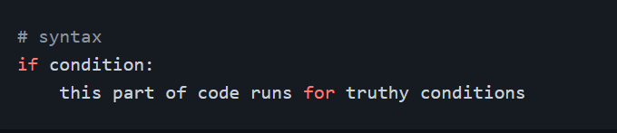
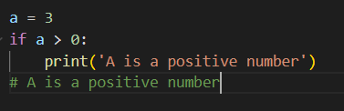
If Condition
In python and other programming languages the key word if is used to check if a condition is true and to execute the block code. Remember the indentation after the colon.
Example: 1

Slide 4
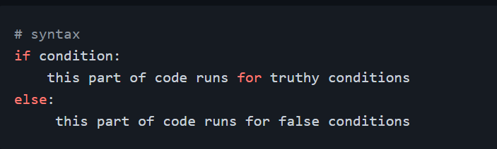
As you can see in the example above, 3 is greater than 0. The condition was true and the block code was executed. However, if the condition is false, we do not see the result. In order to see the result of the falsy condition, we should have another block, which is going to be else.
If Else:
If condition is true the first block will be executed, if not the else condition will run.

Slide 5
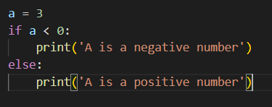
Example:
The condition above proves false, therefore the else block was executed. How about if our condition is more than two? We could use _ elif_.

Slide 6
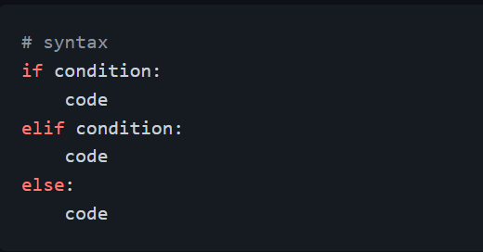
If Elif Else
In our daily life, we make decisions on daily basis. We make decisions not by checking one or two conditions but multiple conditions. As similar to life, programming is also full of conditions. We use elif when we have multiple conditions.

Slide 7
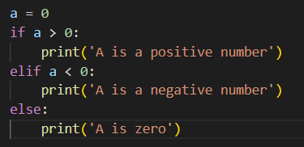
Example:

Slide 8
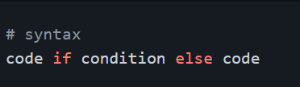

Short Hand
Example:

Slide 9
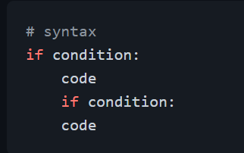
Nested Conditions
Conditions can be nested

Slide 10
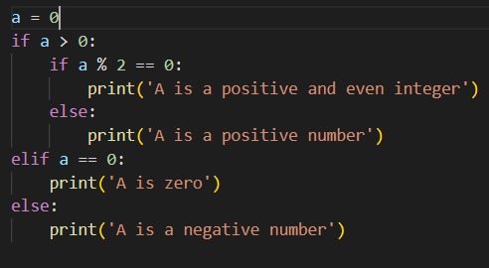
Example:
We can avoid writing nested condition by using logical operator and.

Slide 11
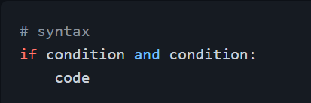
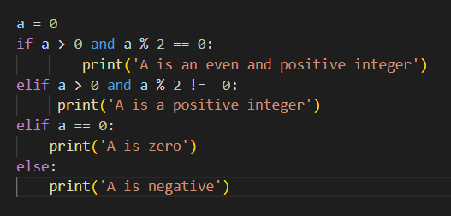
If Condition and Logical Operators
Example:

Slide 12
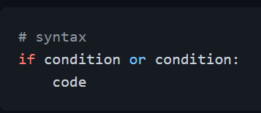
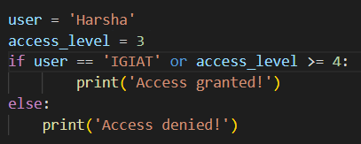
If and Or Logical Operators
Example:

Slide 13
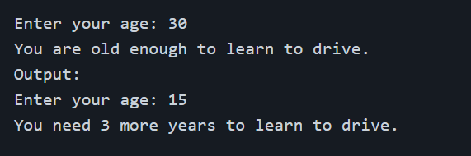
Exercises: Level 1
Get user input using input(“Enter your age: ”). If user is 18 or older, give feedback: You are old enough to drive. If below 18 give feedback to wait for the missing amount of years. Output:

Slide 14
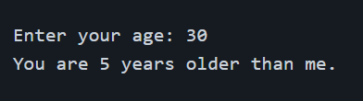
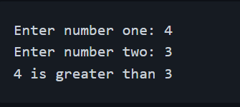
Compare the values of my_age and your_age using if … else. Who is older (me or you)? Use input(“Enter your age: ”) to get the age as input. You can use a nested condition to print 'year' for 1 year difference in age, 'years' for bigger differences, and a custom text if my_age = your_age. Output:
Get two numbers from the user using input prompt. If a is greater than b return a is greater than b, if a is less b return a is smaller than b, else a is equal to b. Output:

Slide 15
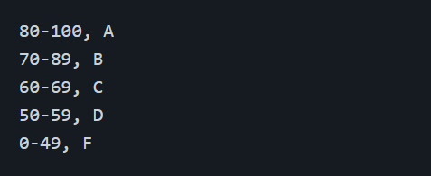
Exercises: Level 2
Write a code which gives grade to students according to theirs scores:
Check if the season is Autumn, Winter, Spring or Summer. If the user input is: September, October or November, the season is Autumn. December, January or February, the season is Winter. March, April or May, the season is Spring June, July or August, the season is Summer

Slide 16

The following list contains some fruits:
If a fruit doesn't exist in the list add the fruit to the list and print the modified list. If the fruit exists print('That fruit already exist in the list')

Slide 17
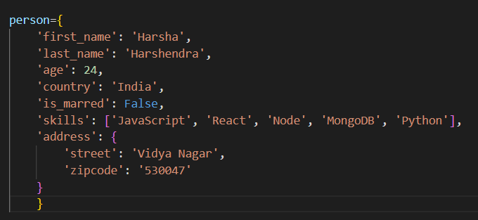
Exercises: Level 3
Here we have a person dictionary. Feel free to modify it!
Go To Next Slide For Questions.

Slide 18
* Check if the person dictionary has skills key, if so print out the middle skill in the skills list.
* Check if the person dictionary has skills key, if so check if the person has 'Python' skill and print out the result.
* If a person skills has only JavaScript and React, print('He is a front end developer'), if the person skills has Node, Python, MongoDB, print('He is a backend developer'), if the person skills has React, Node and MongoDB, Print('He is a fullstack developer'), else print('unknown title') - for more accurate results more conditions can be nested!
* If the person is married and if he lives in Finland, print the information

